Slide 1



Slide 2




15+ Years
100+ Countries
60,000+ Businesses

Slide 3
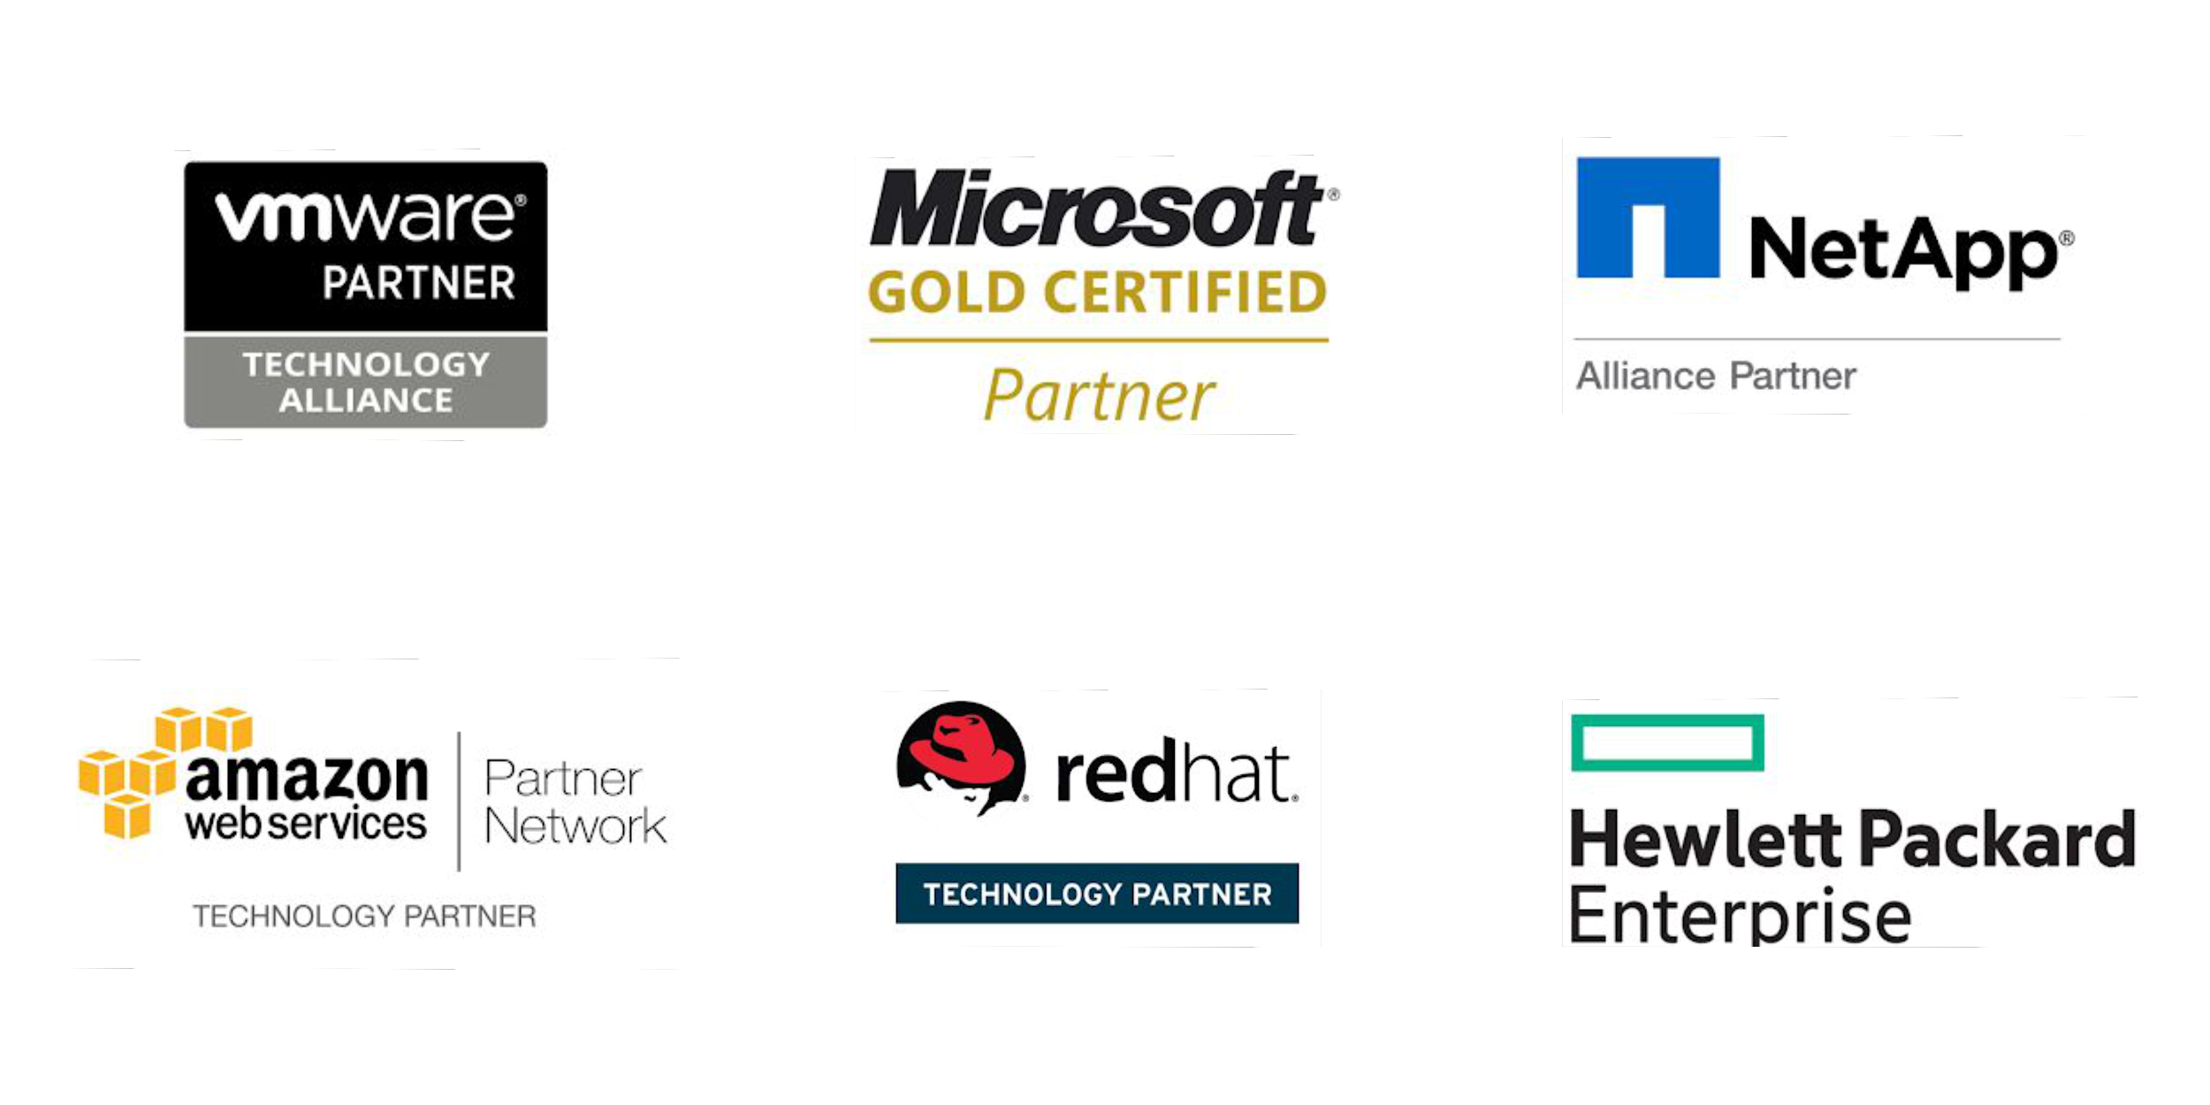
Vembu
Technology Partner
Backup & Disaster Recovery

Slide 4
Vembu BDR Suite
Product Overview

Slide 5










Vembu BDR Suite
Vembu BDR Suite is a portfolio of products designed to backup multiple environments from
virtual to physical to cloud while addressing diverse and advanced use cases
Backup & Replication for VMware
Backup & Replication for Hyper-V
Backup for
Microsoft Windows
Backup for AWS
Backup for
Microsoft 365
Backup for
Google Workspace
Backup for
File Servers
Backup for Endpoints
Backup for
Applications

Slide 6

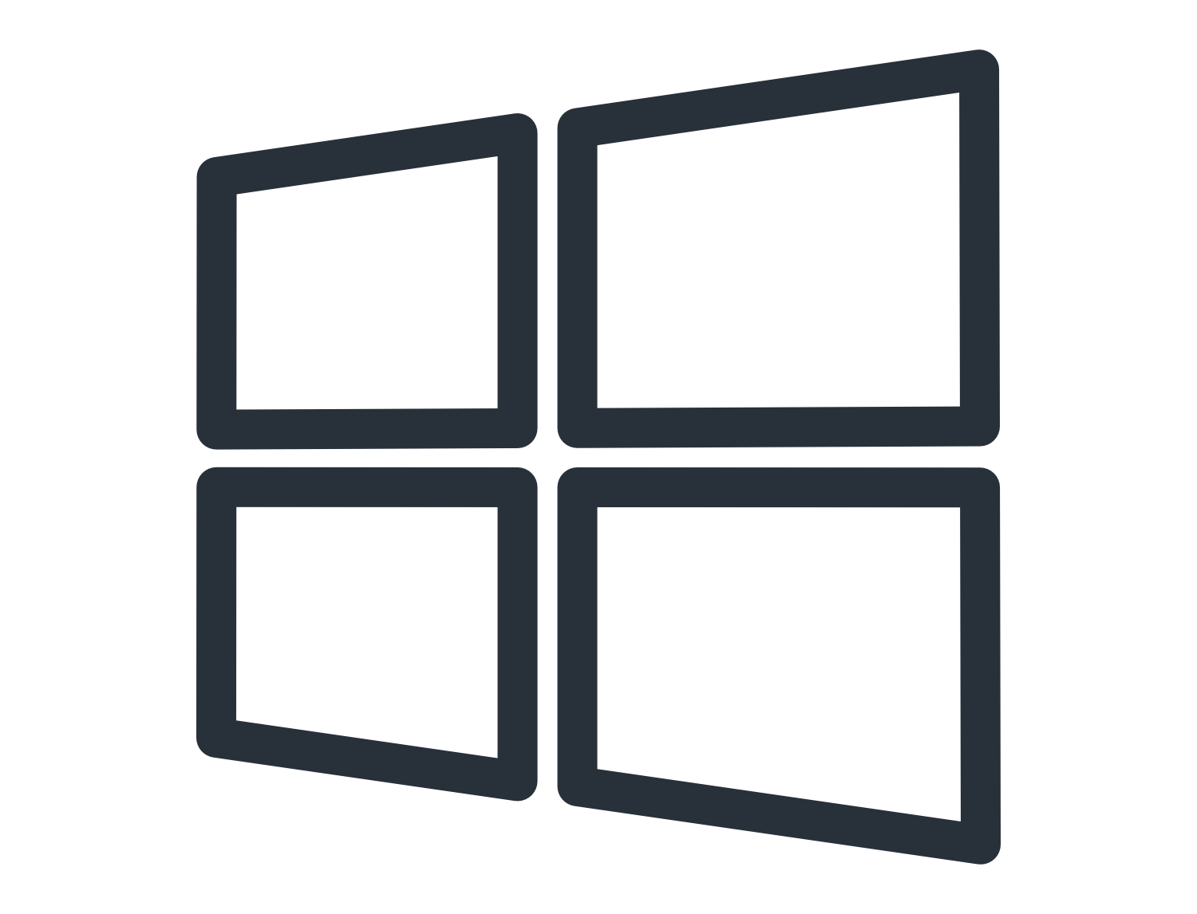
Backup & Replication for Virtual Environment
Backup & Replication for VMware
Backup & Replication for Hyper-V
Vembu Backup & Replication for VMware delivers a powerful, flexible, and fully-featured backup solution that helps organizations to effectively meet the backup demands of their VMware vSphere environment.
Agentless Image-level VM Backup
Near Continuous Data Protection
Direct SAN and Hot-Add transport modes for backup
VMware Changed Block Tracking for incremental backups
VMware Replication for complete Site-level protection
Vembu Backup & Replication for Hyper-V is an effective solution for data protection gaps that businesses experience every day while protecting their virtual machines running on their Hyper-V environments.
Image backup for Hyper-V VMs at Host and Cluster level
Resilient Change Tracking (RCT) based incremental backups
Supports Hyper-V Cluster, CSV, S2D and SMB share
Application-aware backups with Log Truncation
Failover & undo Failover the replicated Hyper-V VMs

Slide 7
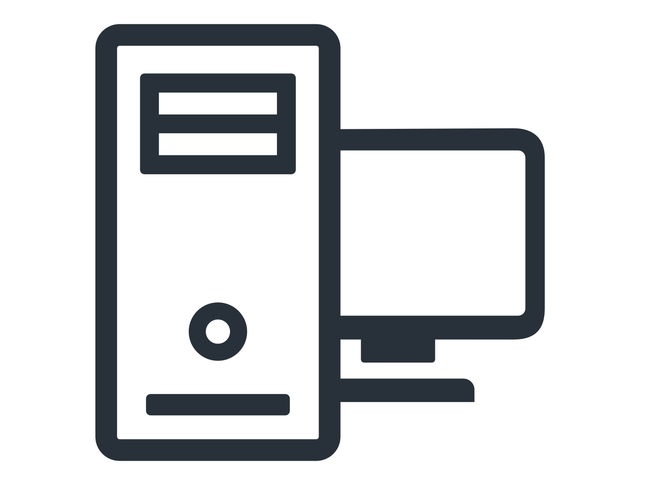
Image Backup for Microsoft Windows
Backup for Microsoft Windows
Vembu Backup for Microsoft Windows allows you to backup the entire disk or a selected partition of Windows systems including its Operating System(OS), boot information, system settings, applications, and files – even while the system is still being used.
Disk-Image based backup for Windows Machines
Supports backup for disks having more than 2 TB of data
Backup both Basic and Dynamic disks in a Windows machine
Supports Bare-metal Recovery (BMR)
Backup disks of MBR, EBR, LDM, and GPT partitions

Slide 8

Backup for Cloud Workloads
Backup for AWS
Vembu Backup for AWS offers a simple, secure and cloud-native AWS backup software for the AWS EC2 instances. You can recover the backup instance, volume or even files at any time with near-zero RTO.
Agentless Cloud-Native Backup for EC2 instances
Near-Continuous Data Protection with Auto Scheduling
Application-Aware Backups
Instance and Volume-level Recovery
Exhaustive Backup and Recovery Reports

Slide 9


Backup for SaaS Applications
Backup for Microsoft 365
Backup for Google Workspace
Vembu Backup for Microsoft 365 is an robust solution that protects emails, contacts, calendar, and one drive of Microsoft 365 by directly backing up locally.
Backup Entire Domain or Specific User Data
Recover Entire Mailbox or Individual Mails
Export to multiple formats like .PST, .EML, .VCF, .ICF, etc...
Restore OneDrive Business Folders with Folder Structure
Backup Sharepoint & Teams and restore them Granularly
Vembu Backup for Google Workspace is an effective solution that ensures protection of emails, contacts, calendar, and google drives by directly backing up to the on prem server.
Backup your entire Domain or select users manually
Store Google Workspace backup data in your local data center
Set a schedule for the backups and run automatically
Search and view the emails of the backed-up user accounts
Detailed and reliable backup and recovery reports

Slide 10
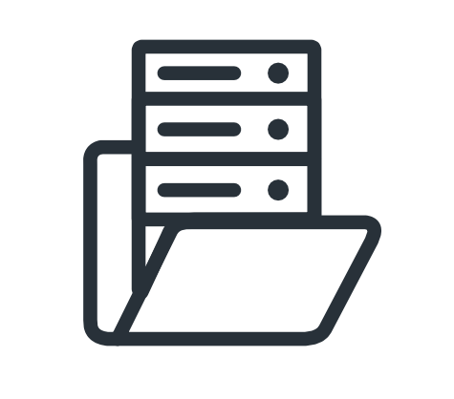


File & Application Backup for Windows, Linux & Mac
Backup for File Servers
Backup for Endpoints
Vembu Backup for File Servers helps to protect your data across file servers of Windows, Linux with enterprise-level functionality.
Continuous Data Protection
Flexible Retention policies
Interruption-free Backup
Vembu Backup for Endpoints ensures protection to critical data across your Windows,. Mac platforms at granular level.
High Compression Ratio
Client/Server Side Restore
Pre/Post Commands
Backup for Applications
Vembu Backup for Applications enhances the data protection of your application servers, by backing up the application items granularly.
MS Exchange, SQL, SharePoint, Outlook and MySQL
Highly secured Encryption and Compression
Granular Application Recovery

Slide 11
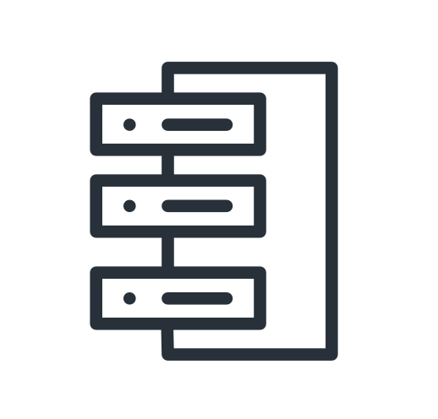

Vembu Offsite/DR Copy
Replicate a secondary copy of your data to an offsite location for disaster recovery purposes, In case of primary site failure, you can restore your data from the offsite storage with minimal downtime.
Vembu Offsite DR
Vembu Cloud DR
Devise a reliable DR plan for your business by replicating a copy of the backup data from your on-premise data center to an offsite server.
WAN-optimized Live Data Transfer
Restore directly from the offsite server
Throttle the speed of the data transfer
Seamless Live Data Transfer
Seed the Huge Full Backup data to Offsite DR Server
Reinforce your Disaster Recovery plan by replicating the copy of backup data from your on-premise data center to Vembu Cloud.
Backup data encryption both in-flight and at-rest
Restore the replicated data anywhere and anytime
WAN accelerated data transfer
Download the backup data in VHD, VMDK file formats
Recover the replicated data granularly

Slide 12



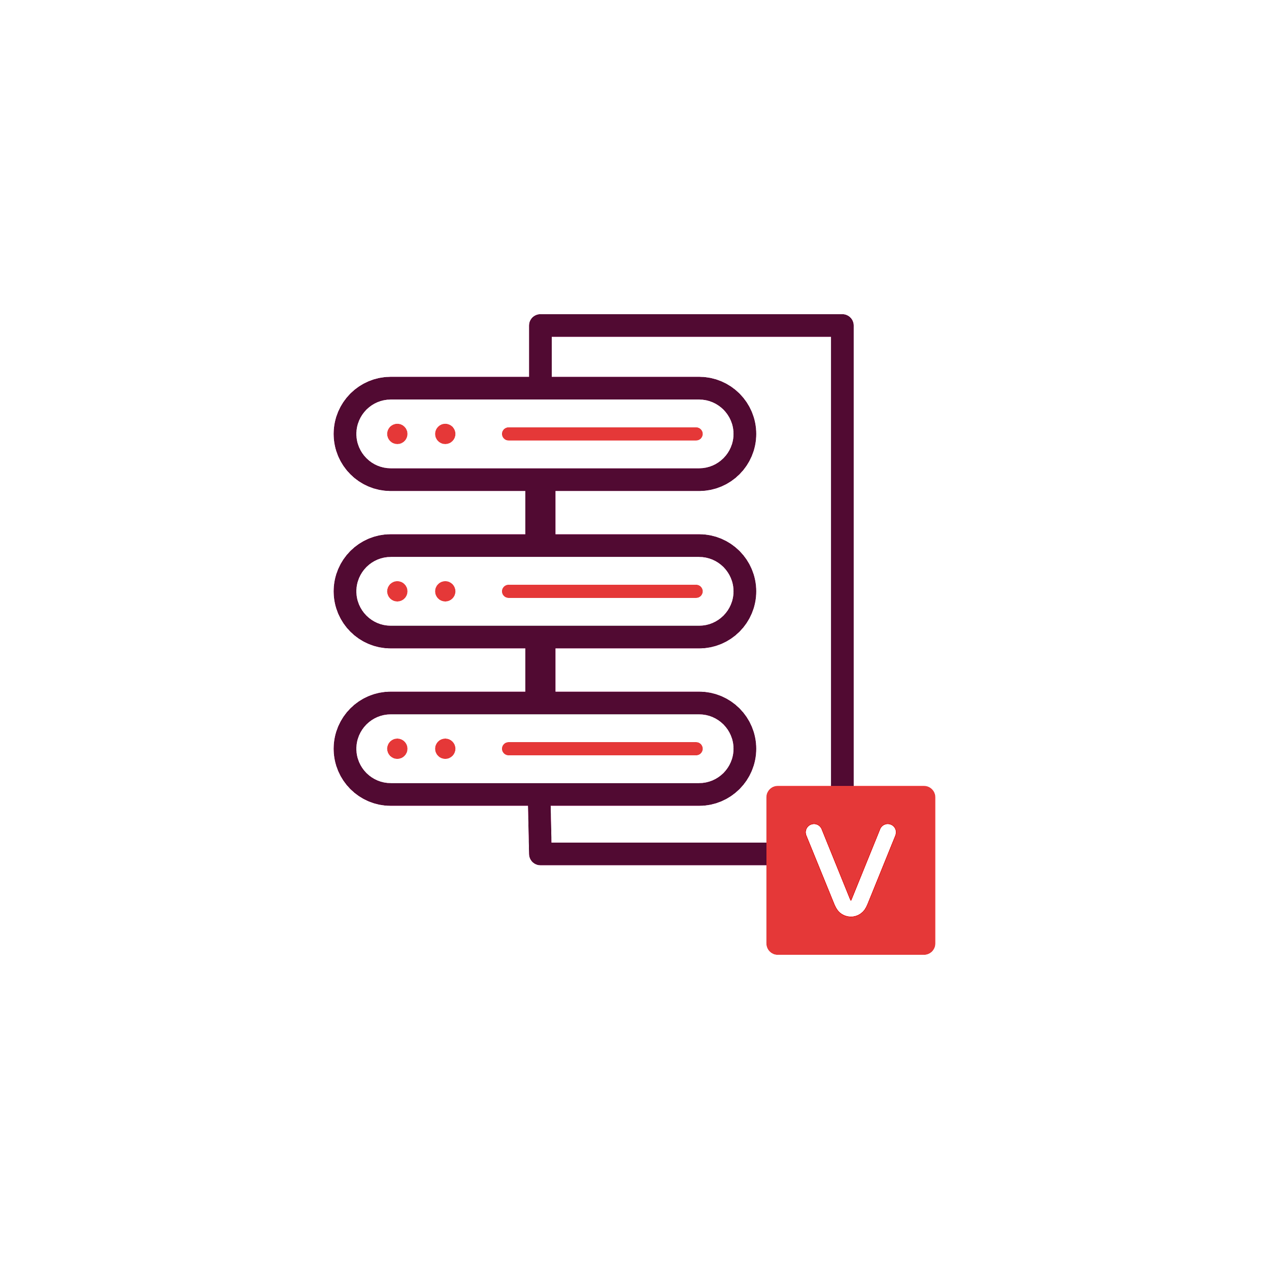
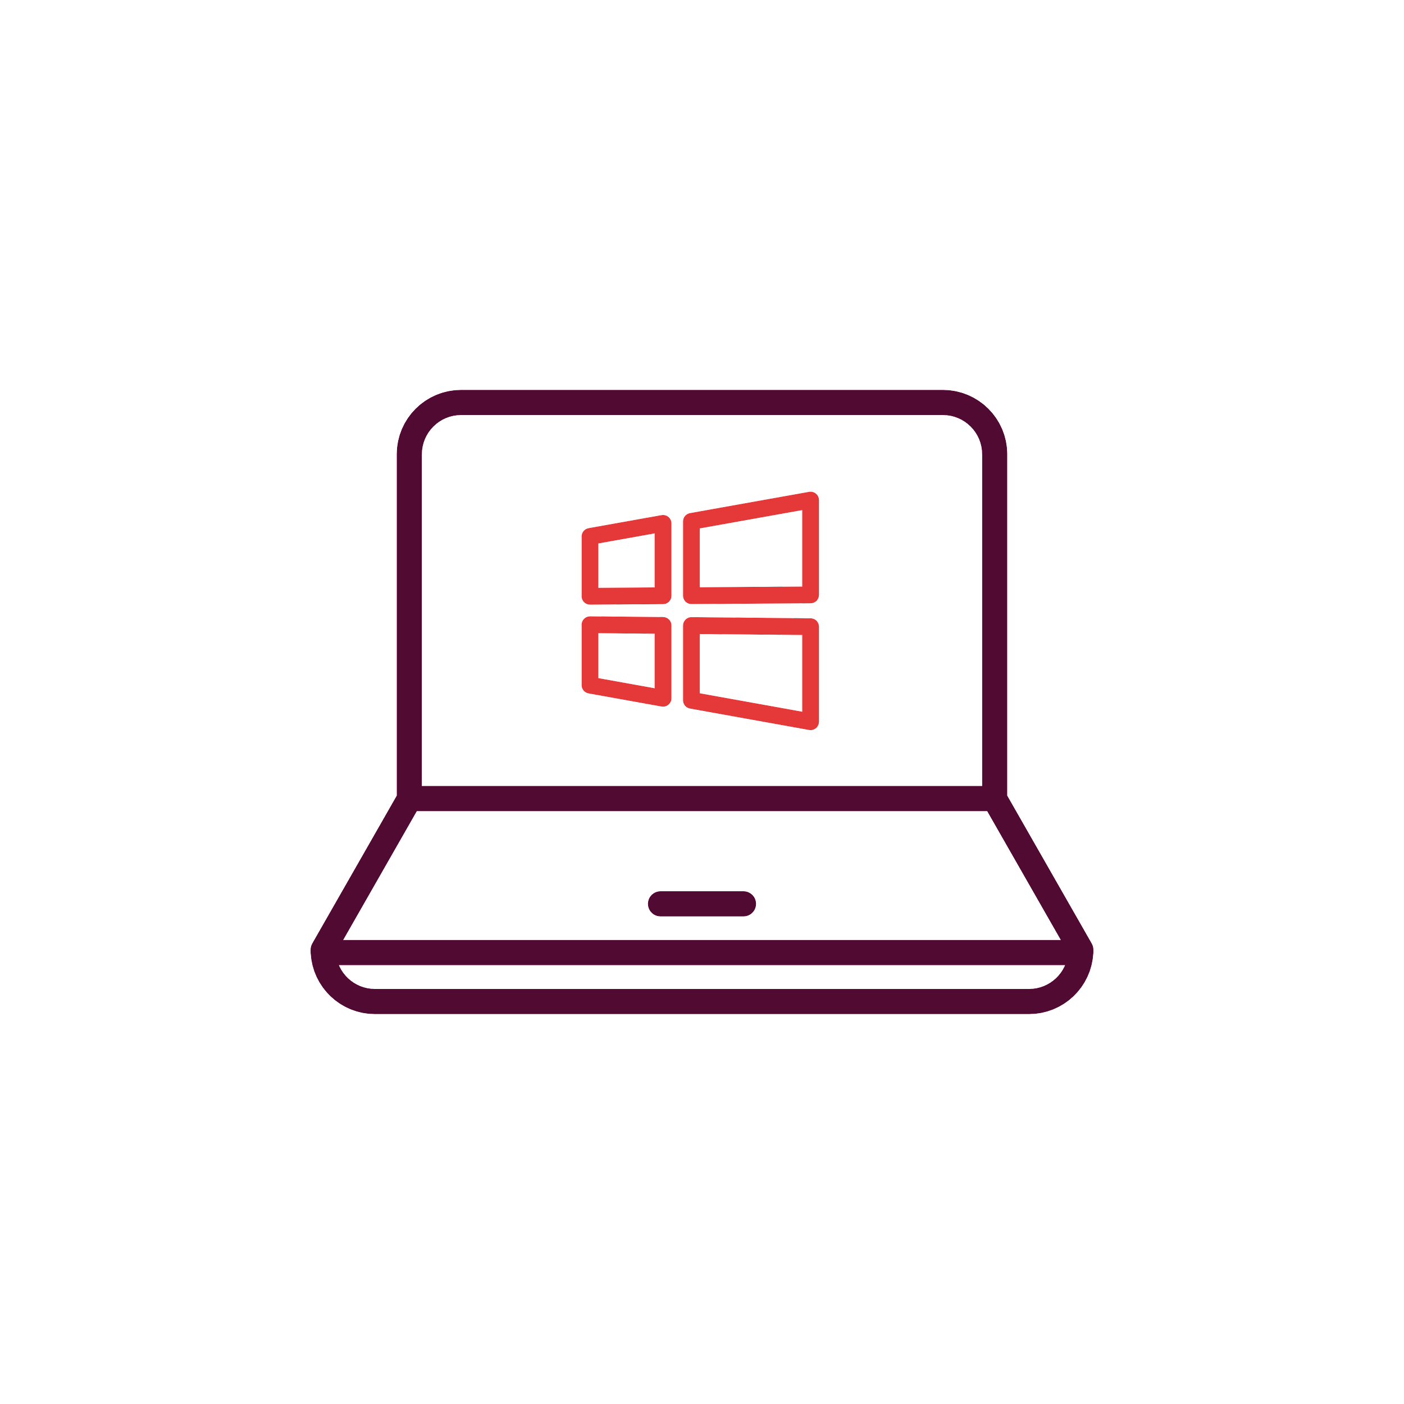
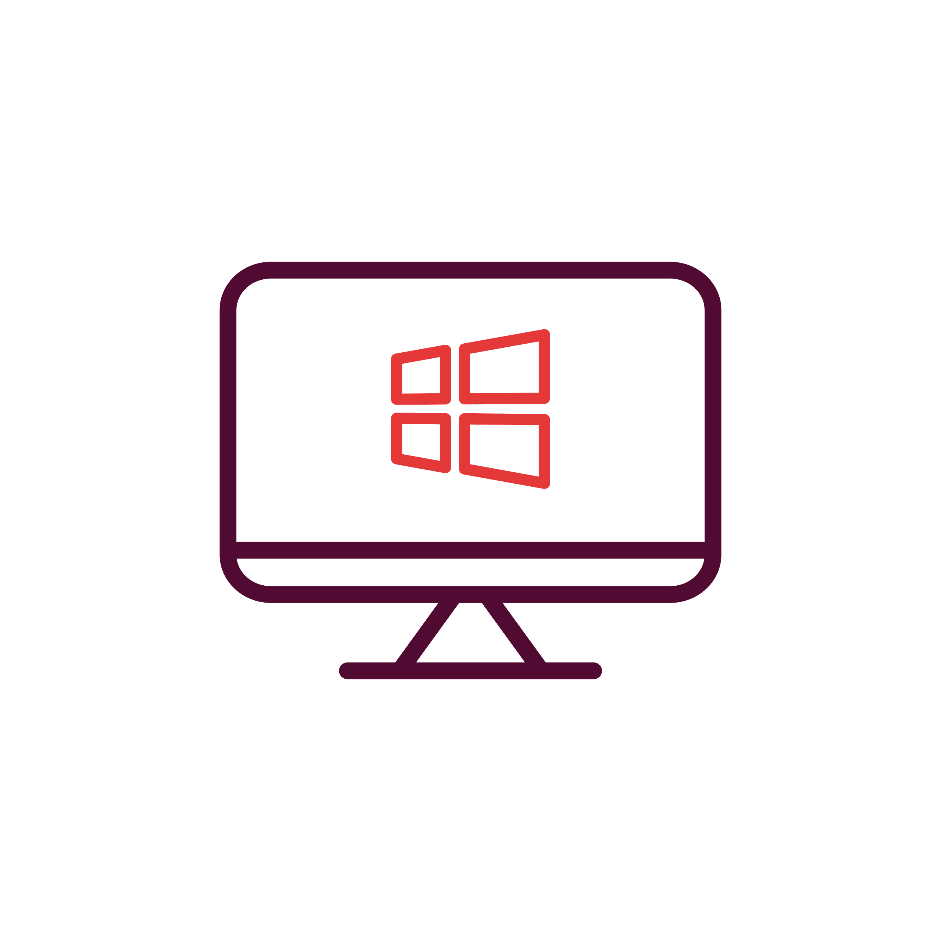
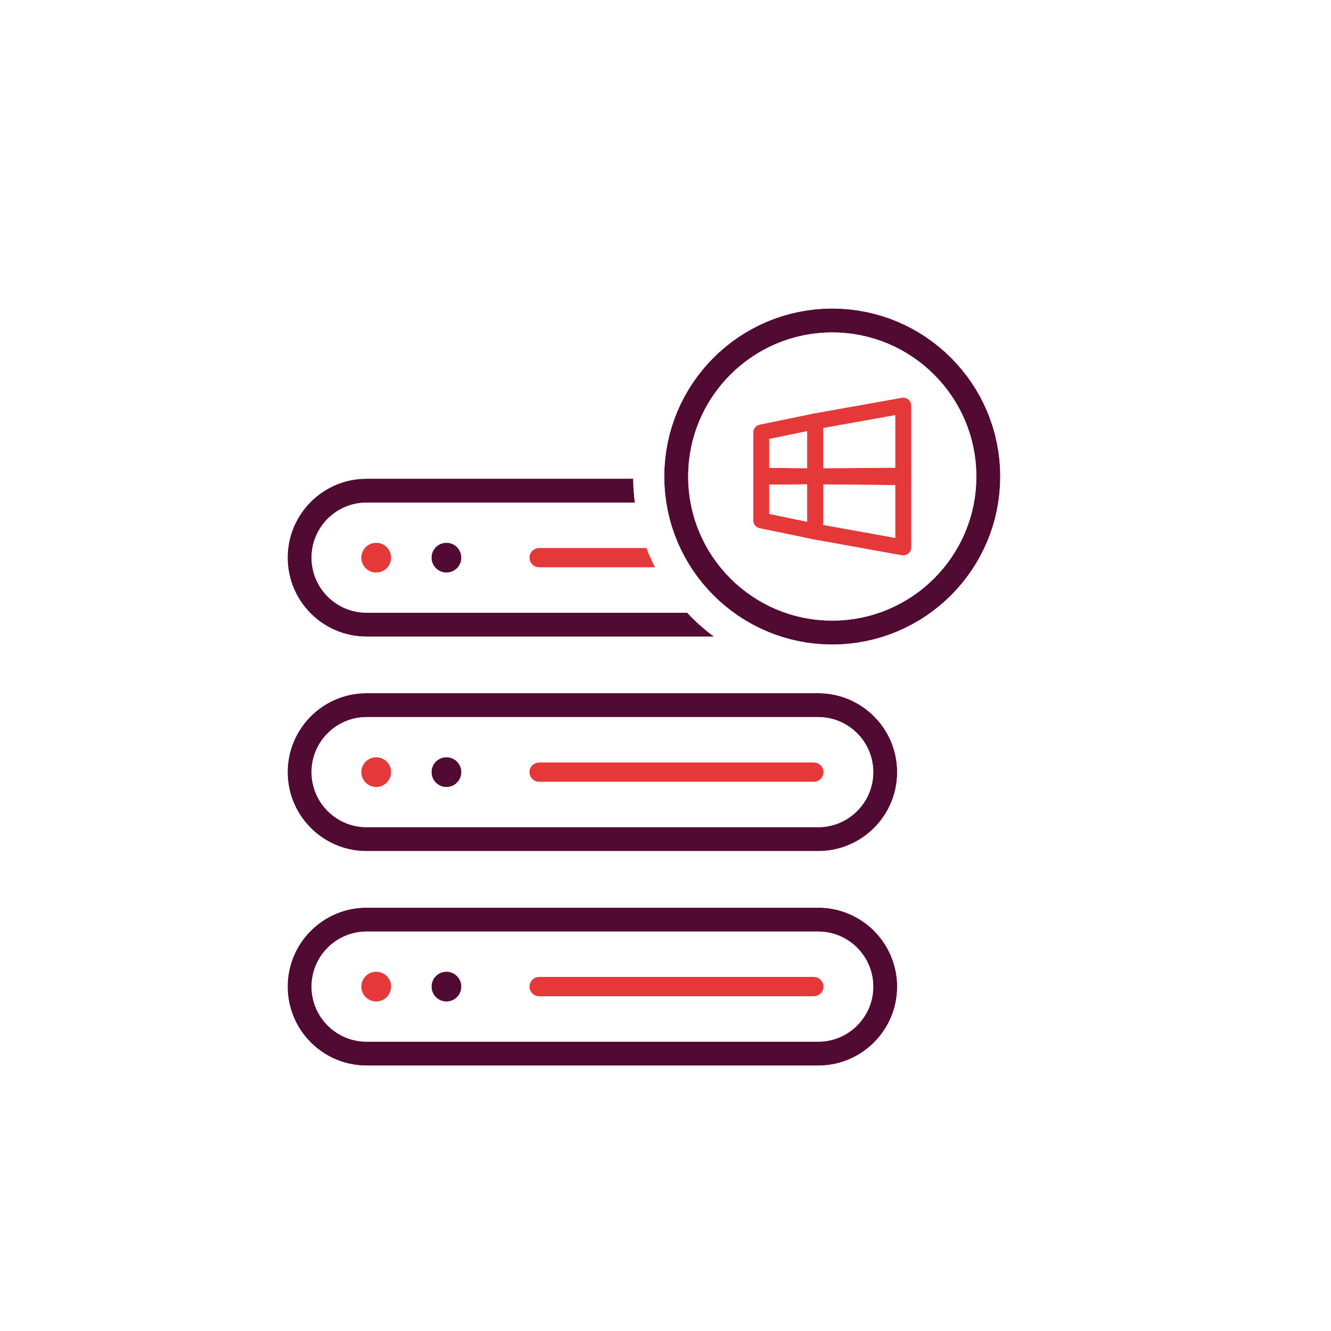




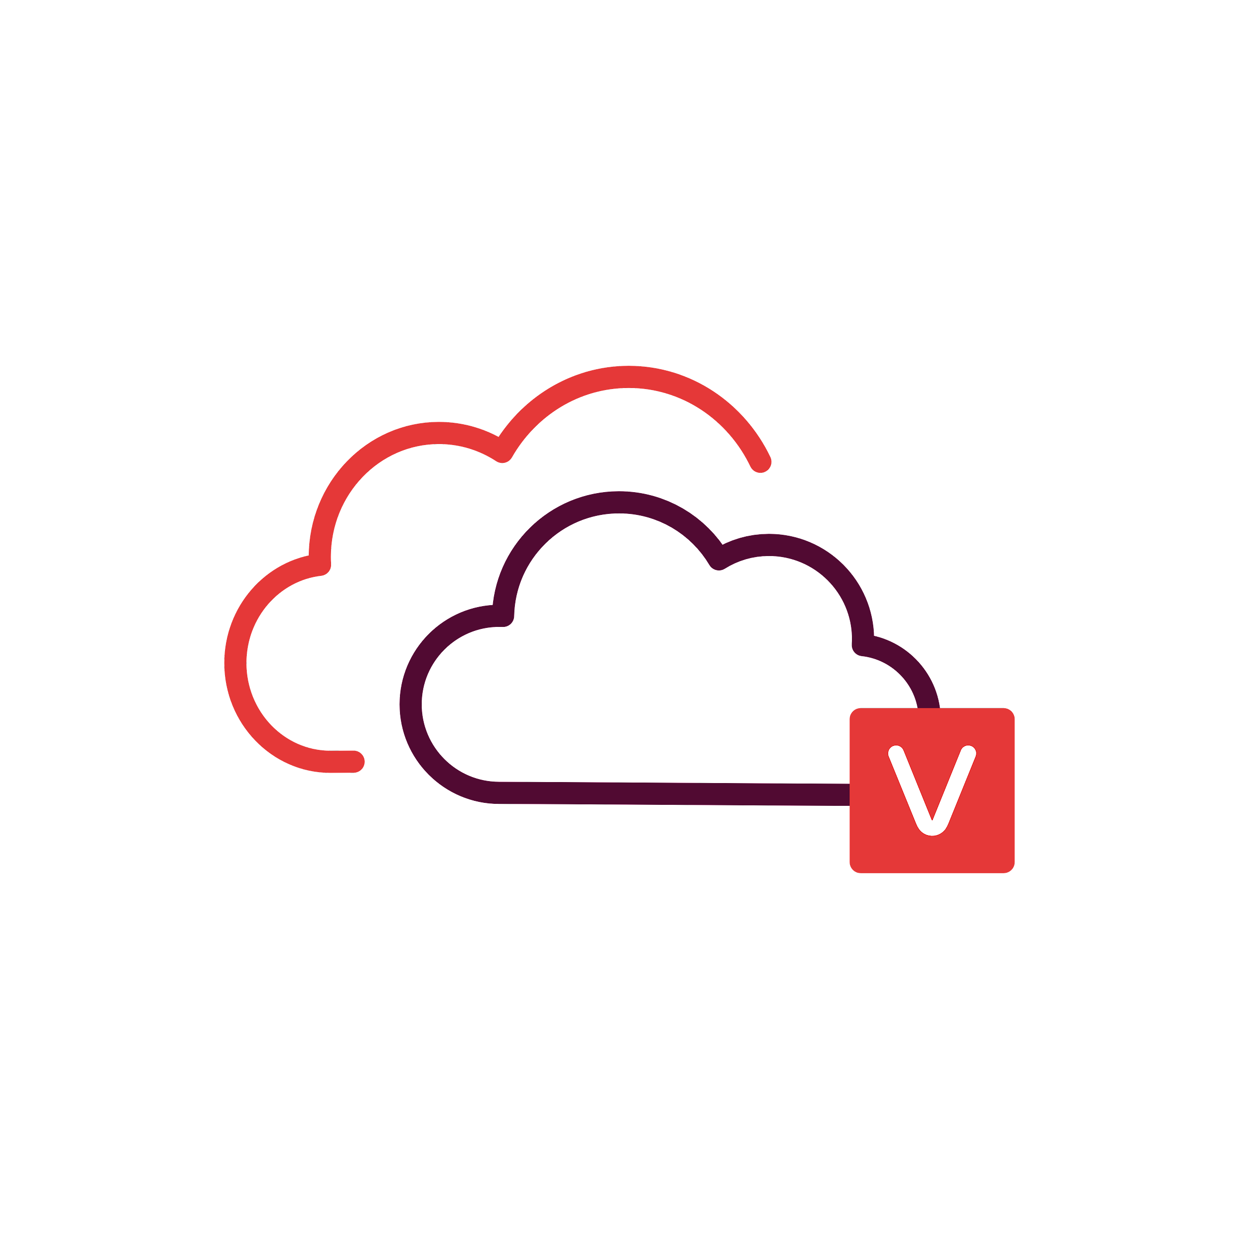



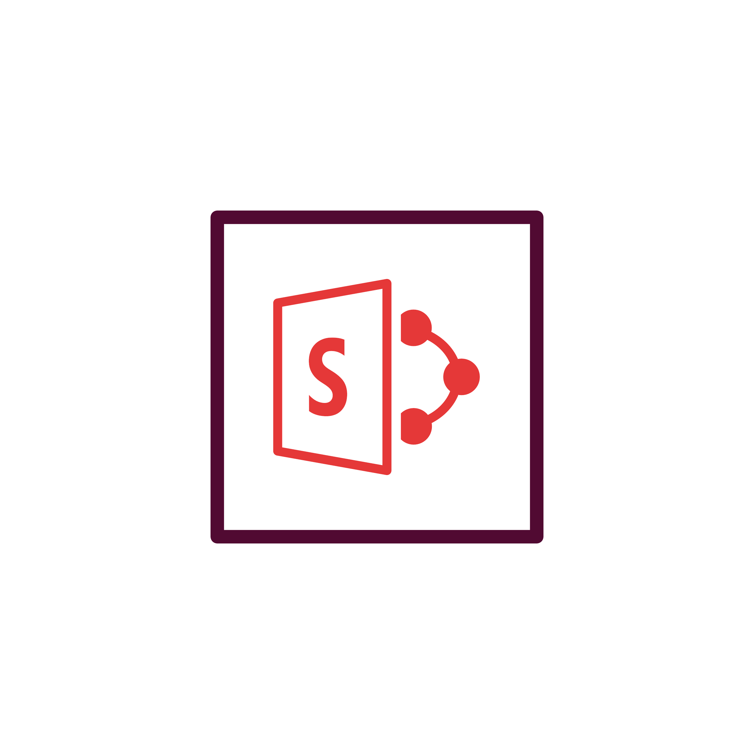




Image Level Backup
VMware
Hyper-V
Vembu Portal
(For Licensing)
Vembu BDR Architecture
Vembu Offsite DR
Server
Windows Server & Workstations
AWS EC2 Instance
Vembu BDR Backup
Server
Microsoft 365
Google Workspace
Vembu Cloud DR
File Servers/ Endpoints/Applications
Backup & Disaster Recovery

Slide 13
Vembu BDR Suite
Key features

Slide 14







Key Backup & Replication Features of Vembu BDR Suite
Multi-host Backup
Parallel VM Processing
Sharepoint & Teams Backup
Create a backup job with multiple-hosts and configure to run parallel thus improving backup performance.
Vembu now supports parallel backup of multiple VMs/disks in a single host
Now backup Microsoft 365 applications i,e, Sharepoint and Teams; and restore them granularly.
Synthetic Full Backup
Native Tape Backup Support
Backup Job Template
Synthetic full backups are created in the backup repository by merging the full backup and all subsequent incremental backups in the backup repository itself
The frequently used backup configuration settings or as per some predefined backup policies, you can utilize these templates to create new backup jobs quickly.
Archive your backup data on tape drives for long-term retention.

Slide 15






Key Recovery Features of Vembu BDR Suite
RPO and RTO <15 mins
GFS Retention
Multiple Recovery Options
Minimize your downtime to less than 15 mins with quick VM recovery, disk mounts & granularly recover file/apps.
GFS retention helps to create restore points on a weekly, monthly, quarterly, and yearly basis.
Multiple restore options helps to restore the backup data granularly, perform cross-platform migration, instantly boot as VM, Download in various file-formats and also perform Bare-Metal Recovery
Instant Boot Live Migration
Applications item-level Recovery
Reliable Backups
A permanent migration process where the virtual/ physical machine backup that is instantly booted as VM can be migrated as an independent VM to a targeted VMware Host.
Granularly restore Microsoft applications at item level directly from the BDR Backup Server web GUI
Automated 3-tier backup verification – boot, mount & data integrity tests to ensure recoverability data.

Slide 16






Other Key Features of Vembu BDR Suite
Efficient Storage Management
Compression
Backup Level encryption
Vembu BDR Backup Server utilizes VembuHIVE™ file system to effectively manage storage repositories..
Built-in compression and deduplication to reduce the storage space with the ability to scale as & when required.
Use system-generated passwords or add your own, to encrypt the backup data using AES-256 bit encryption algorithm.
Drive Rotation
Where it left off
Reporting
It helps you to use multiple external hard drives to store the backup data and swap them on a regular basis.
Even if there is a network failure or other interruptions during backup, the backup will automatically restart from where it left off during the previous schedule
Users can manage all their backups with Backup Status Reports, VM Status Reports, Integrity Report and Restore Report

Slide 17

Vembu BDR Suite Licensing

Slide 18

Standard
Essentials
EnterpriseEssentials
Standard
Enterprise
Upto 10 sockets or
100 VMsv
Upto 10 sockets or 100 VMs
Subscription License: Includes product updates, upgrades and standard technical support during the subscription period
CPU Socket level pricing
$108
$216
$180
$360
Backup & Replication for VMware/Hyper-V
per cpu-socket/annum
per cpu-socket/annum
per cpu-socket/annum
per cpu-socket/annum
VM level pricing
$18
$36
$30
$60
per vm/annum
per vm/annum
per vm/annum
per vm/annum
Perpetual License: Free maintenance & support for 1st year
CPU Socket level pricing
$270
$540
$450
$900
per cpu-socket
per cpu-socket
per cpu-socket
per cpu-socket
VM level pricing
$45
$90
$75
$150
per vm
per vm
per vm
per vm
Backup & Disaster Recovery

Slide 19

Workstation
Server
Backup
for
Microsoft Windows
Subscription License
$15
$60
(Includes product updates, upgrades & standard technical support until subscription period)
per workstation/annum
per server/annum
Perpetual License
$37.50
$150
(Free maintenance & support for 1st year)
per workstation
per server
Backup & Disaster Recovery

Slide 20
EC2 Instance
Backup
for
AWS
Subscription License
$30
(Includes product updates, upgrades & standard technical support until subscription period)
per Instance/annum
Perpetual License
$75
(Free maintenance & support for 1st year)
per Instance
Backup & Disaster Recovery

Slide 21
Microsoft 365
Backup
for
Microsoft 365
Subscription License
$12
(Includes product updates, upgrades & standard technical support until subscription period)
per user/annum
Perpetual License
$30
(Free maintenance & support for 1st year)
per user
Backup & Disaster Recovery

Slide 22
Google Workspace
Backup
for
Google Workspace
Subscription License
$12
(Includes product updates, upgrades & standard technical support until subscription period)
per user/annum
Perpetual License
$30
(Free maintenance & support for 1st year)
per user
Backup & Disaster Recovery

Slide 23

File Servers
Endpoints
Applications
Backup for
File Servers, Endpoints & Applications
Windows & Linux Servers
Windows & Mac OS
(MS Exchange, SQL, SharePoint, Outlook & MySQL)
Subscription License
$60
$15
$60
(Includes product updates, upgrades & standard technical support until subscription period)
per server/annum
per endpoint/annum
per application/annum
Perpetual License
$150
$37.50
$150
(Free maintenance & support for 1st year)
per server
per endpoint
per application
Backup & Disaster Recovery

Slide 24
Thank You
USA & CANADA
+1-512-256-8699
UNITED KINGDOM
+44-203-793-8668
Email
vembu-sales@vembu.com
vembu-support@vembu.com

