Slide 2
15+ Years
100+ Countries
60,000+ Businesses

Slide 3
Vembu
Technology Partner

Slide 4
Vembu BDR Suite
Product Overview

Slide 5
Vembu BDR Suite
Vembu BDR Suite is a portfolio of products designed to backup multiple environments from
virtual to physical to cloud while addressing diverse and advanced use cases
Backup & Replication for VMware
Backup & Replication for Hyper-V
Backup for
Microsoft Windows
Backup for AWS
Backup for
Microsoft 365
Backup for
Google Workspace
Backup for
File Servers
Backup for Endpoints
Backup for
Applications

Slide 6
Vembu Backup for Microsoft 365

Slide 7
Vembu Backup for Microsoft 365 performs agentless, incremental, daily backups for your Microsoft 365 Mails, Contacts, Calendars, OneDrive, Sharepoint online, and Teams by leveraging Microsoft’s Graph API. By adding your Office 365 domain with Vembu Microsoft 365 backup, you schedule automated daily backups for your Office 365 data.
Backup Entire Domain or Specific User Data
Restore OneDrive Business Folders with Folder Structure
Export to multiple formats like .PST, .EML, .VCF, .ICF, etc...
Backup for
Microsoft 365
Backup & Disaster Recovery

Slide 8
Vembu BDR Suite
Deployment

Slide 9
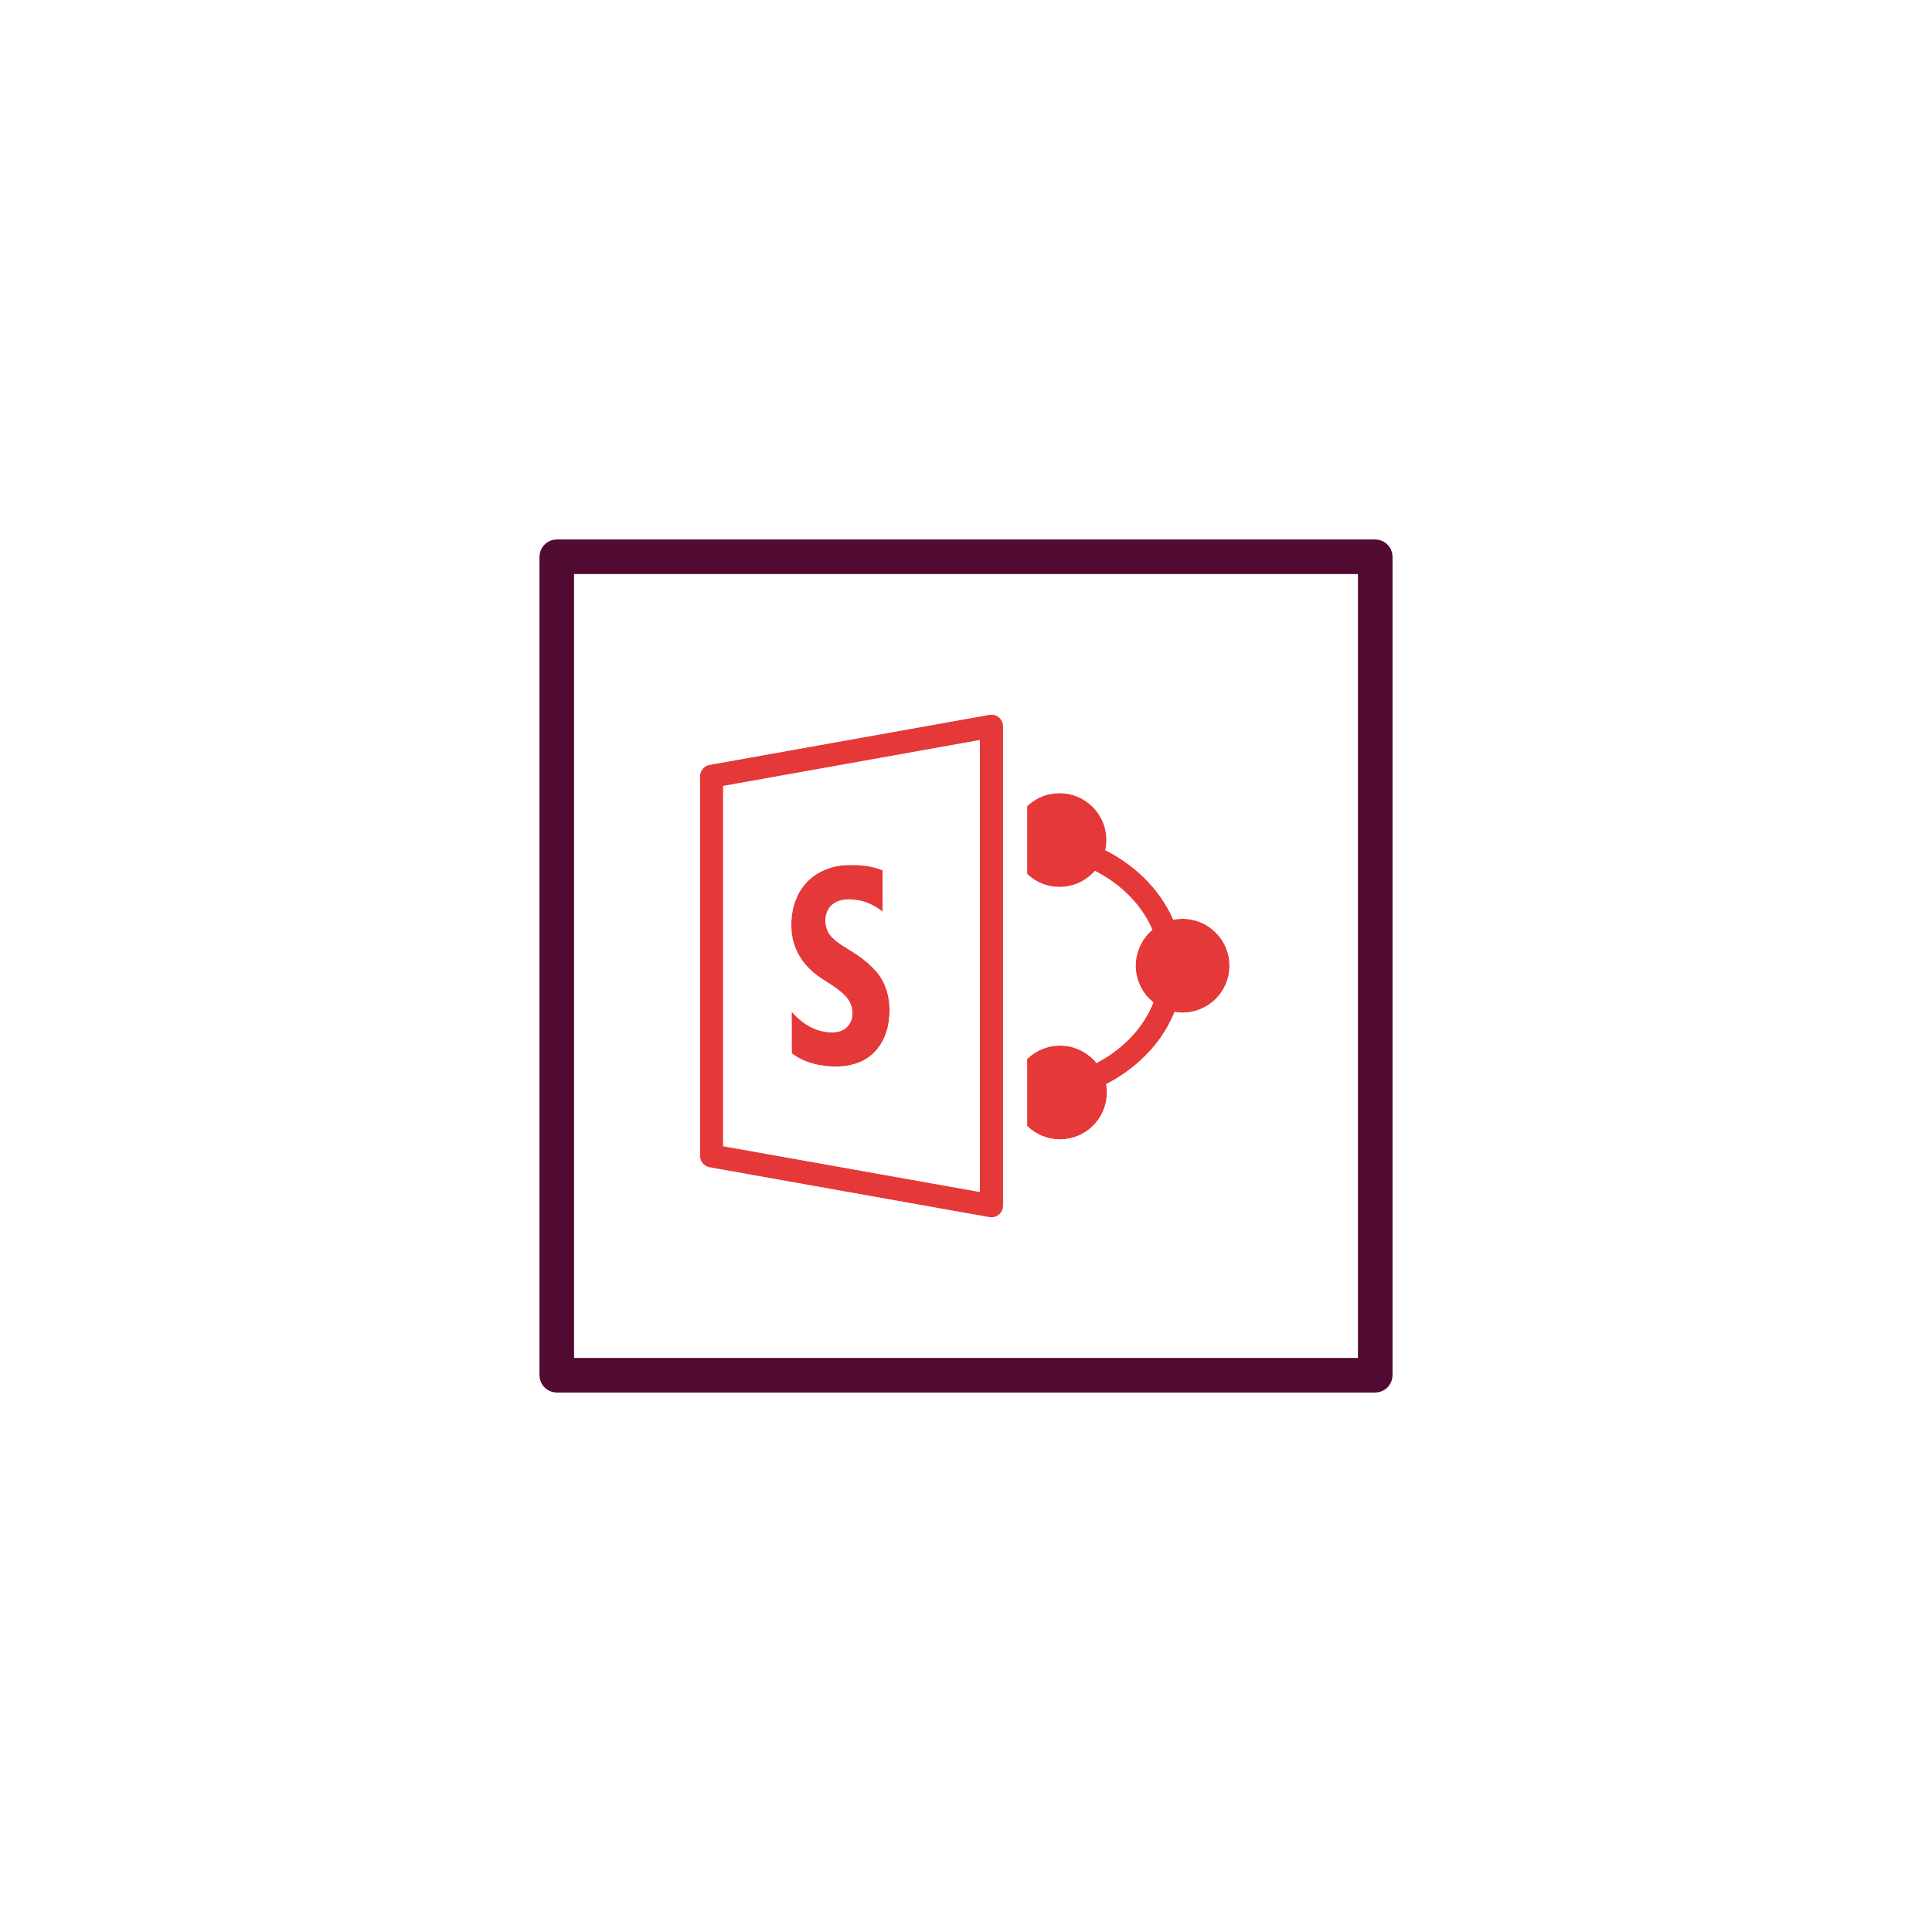
Ideal setup for businesses looking to manage backups for their premises either it may be a large one or a small environment.
Setup BDR Backup Server in your local environment and backup via LAN
Configure and manage backup jobs from BDR Backup Server GUI
Backup the SaaS application data to the storage repositories attached to the backup server
On-premise Deployment - Simple
WAN
Vembu BDR Backup Server
Backup & Disaster Recovery

Slide 10
Vembu BDR Suite
Key features

Slide 11
Key Backup Features for Microsoft 365
Domain or User-level backup
Exchange Online Backup
SharePoint Online Backup
Vembu allows you to configure agentless backups at domain-level or user-level for your office 365 account.
Protect your Exchange Online by backing up email accounts including inbox, sent items, other custom labels, and also the files with attachments.
Backup for Microsoft 365 takes a copy of your SharePoint data, including Sites, Libraries and Folder/Items, etc., and stores them locally.
Microsoft OneDrive Backup
Group/Shared Mailbox Backup
Microsoft Teams Backup
Backup Onedrive for business data like documents, folders – including photos, videos, etc
The critical files are backed up, and protected in Teams.With Vembu, you can also safely back up, manage, restore, and protect teams along with other Microsoft 365 essential items
Backup for Microsoft 365 takes a copy of your Shared/Group Mailboxes data, including Group conversation and Group Onedrive data, and stores them on-premise.

Slide 12
Key Restore Features for Microsoft 365 Backup
One-Click Restore
Cross-user Restore
Entire Mailbox/Folder-level Restore
Admin users can restore backup data either to the original user account (from where the data was backed up) or to a different user account within the same domain.
Vembu Backup for Microsoft 365 allows users to restore entire mailboxes, or to recover only folders of the backed-up users.
With just a click you can restore your mails, contacts, drives, and calendars to the same user or different user account in Microsoft 365
Search and Retrieve Items
Multiple Export including .PST
Restore with Folder Structure
Vembu allows you to search the emails, attachments, and OneDrive files by providing keywords and restoring exactly what you need when you need it.
With Vembu you can export the mail, contacts and mail items into .pst, .eml, .vcf, and .icf formats.
Vembu preserves the entire folder hierarchy of your Microsoft 365 data while restoring those folders from the backup.

Slide 13
Other Key Features of Microsoft 365 Backup
Efficient Storage Management
Compression
End-to-End Encryption
Vembu BDR Backup Server utilizes VembuHIVE™ file system to effectively manage storage repositories..
Built-in compression and deduplication to reduce the storage space with the ability to scale as & when required.
The backup data is encrypted using the AES-256 bit algorithm to protect the data both in flight and at rest.
Disaster Recovery
Email Notifications
Reporting
Vembu protects your data by providing the option of replicating a copy of your Microsoft 365 data in any cloud object storage like AWS S3, Azure Blob, etc...
Enable email notifications to get alerts on the actual status of the configured backups (like success, failure, missed).
Users can manage all their backups with Backup Status Reports, Restore Reports, etc...

Slide 14
Vembu Backup for Microsoft 365
Licensing Model

Slide 15
Licensing
Subscription
Available Editions
Vembu offers licensing options at monthly & yearly subscriptions
24/7 support and major/minor upgrades included
Free
Standard
Perpetual
Free Edition - SaaS Backup
One time purchase with upgrades and support free for one year
After 1 year AMC of 20% of license fee to be paid for continued support & updates
Backup and restore upto 10 Microsoft 365 Users’ data for free without any feature restrictions,

Slide 16
Microsoft 365
Backup for
Microsoft 365
Subscription License
$12
(Includes product updates, upgrades & standard technical support until subscription period)
per User/ annum
Perpetual License
$30
(Free maintenance & support for 1st year)
per User
Backup & Disaster Recovery

Slide 17
Thank You
USA & CANADA
+1-512-256-8699
UNITED KINGDOM
+44-203-793-8668
Email
vembu-sales@vembu.com
vembu-support@vembu.com

