Slide 1



Slide 2




15+ Years
100+ Countries
60,000+ Businesses

Slide 3
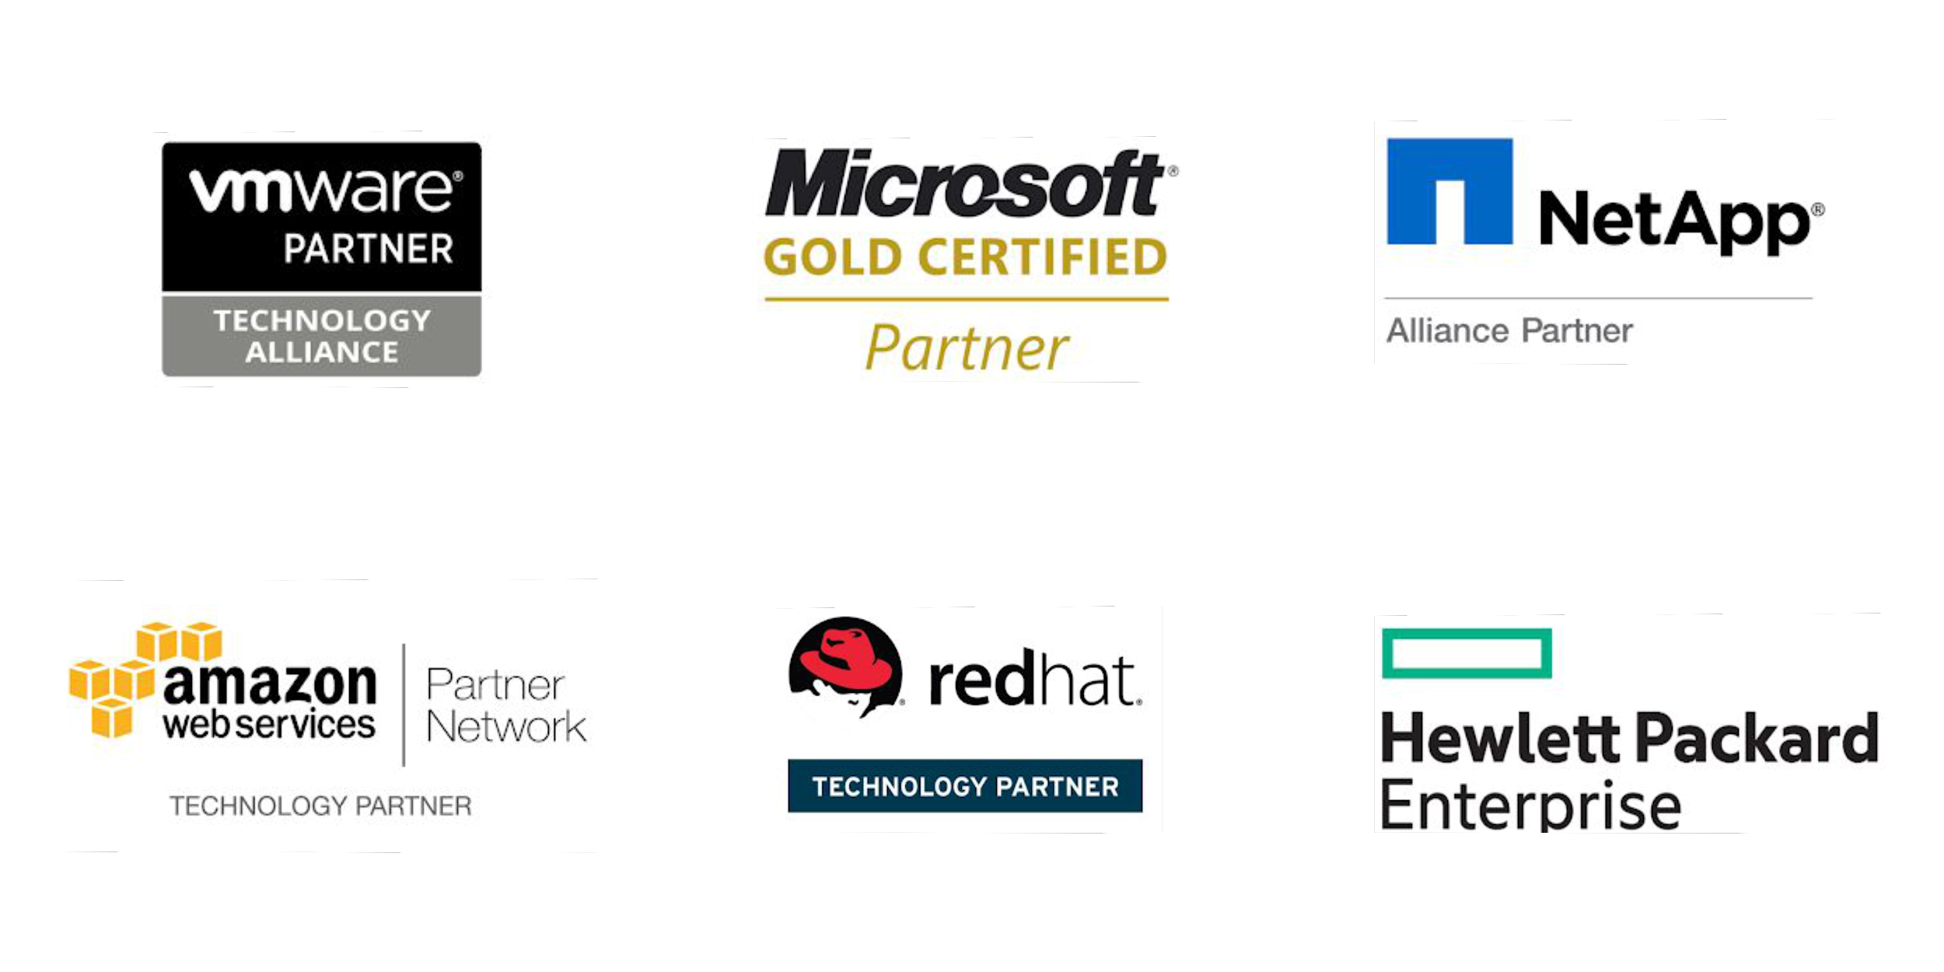
Vembu
Technology Partner

Slide 4
Vembu BDR Suite
Product Overview

Slide 5










Vembu BDR Suite
Vembu BDR Suite is a portfolio of products designed to backup multiple environments from
virtual to physical to cloud while addressing diverse and advanced use cases
Backup & Replication for VMware
Backup & Replication for Hyper-V
Backup for
Microsoft Windows
Backup for AWS
Backup for
Microsoft 365
Backup for
Google Workspace
Backup for
File Servers
Backup for Endpoints
Backup for
Applications

Slide 6
Vembu Backup for Google Workspace

Slide 7

Vembu Backup for Google Workspace is an effective solution that ensures protection of emails, contacts, calendar, and google drives by directly backing up to the on prem server. By adding your Google Workspace account with Vembu BDR Backup Server, you schedule automated daily backups for your Google Workspace data.
Backup Entire Domain or Specific User Data
Store Google Workspace backup data in your local data center
Restore selected user mailbox or individual mails
Backup for
Google Workspace
Backup & Disaster Recovery

Slide 8
Vembu BDR Suite
Deployment

Slide 9






Ideal setup for businesses looking to manage backups for their premises either it may be a large one or a small environment.
Setup BDR Backup Server in your local environment and backup via LAN
Configure and manage backup jobs from BDR Backup Server GUI
Backup the SaaS application data to the storage repositories attached to the backup server.
On-premise Deployment - Simple
WAN
Vembu BDR Backup Server
Backup & Disaster Recovery

Slide 10
Vembu BDR Suite
Key features

Slide 11







Key Backup Features for Google Workspace
Domain or User-level backup
Agentless Backup
Gmail Backup
Vembu allows you to configure agentless backups at domain-level or user-level for your Google Workspace account.
Vembu offers an agentless solution that simplifies the management and maintenance of your Google Workspace data.
Vembu offers a secure and robust incremental backup solution to protect your Google mailboxes along with its attachments from data loss.
Google Calendar Backup
Google Contacts Backup
Backup for G-Drive
Backup your Google account’s calendar items such as events, meetings, schedules, and appointments to the locally attached storage repository.
Secure your Google contacts and its related items locally using Vembu Backup for Google Workspace.
Protect your Google Drive data like documents, folders – including photos, videos, etc... using Vembu.

Slide 12






Key Restore Features for Google Workspace Backup
One-Click Restore
Cross-user Restore
Entire Mailbox/Folder-level Restore
Admin users can restore backup data either to the original user account (from where the data was backed up) or to a different user account within the same domain.
Vembu Backup for Google Workspace allows users to restore entire mailboxes, or to recover only folders of the backed-up users.
With just a click you can restore your mails, contacts, drives, and calendars to the same user or different user account in Google Workspace.
Search and Retrieve Items
Multiple Export including .PST
Restore with Folder Structure
Vembu allows you to search the emails, attachments, and G-Drive files by providing keywords and restoring exactly what you need when you need it.
With Vembu you can export the mail, contacts and mail items into .pst, .eml, .vcf, and .icf formats.
Vembu preserves the entire folder hierarchy of your G-drive data while restoring those folders from the backup.

Slide 13






Other Key Features of Google Workspace Backup
Efficient Storage Management
Compression
End-to-End Encryption
Vembu BDR Backup Server utilizes VembuHIVE™ file system to effectively manage storage repositories..
Built-in compression and deduplication to reduce the storage space with the ability to scale as & when required.
The backup data is encrypted using the AES-256 bit algorithm to protect the data both in flight and at rest.
Disaster Recovery
Email Notifications
Reporting
Vembu protects your data by providing the option of replicating a copy of your Google Workspace data in any cloud object storage like AWS S3, Azure Blob, etc...
Enable email notifications to get alerts on the actual status of the configured backups (like success, failure, missed).
Users can manage all their backups with Backup Status Reports, Restore Reports, etc...

Slide 14

Vembu Backup for Google Workspace
Licensing Model

Slide 15
Licensing
Subscription
Available Editions
Vembu offers licensing options at monthly & yearly subscriptions
24/7 support and major/minor upgrades included
Free
Standard
Perpetual
Free Edition - SaaS Backup
One time purchase with upgrades and support free for one year
After 1 year AMC of 20% of license fee to be paid for continued support & updates
Fully featured backup and recovery for your Google Workspace items such as Mails, Contacts, Calendars, and G-Drive for free – Limited upto 10 users

Slide 16

Google Workspace
Backup for
Google Workspace
Subscription License
$12
(Includes product updates, upgrades & standard technical support until subscription period)
per User/ annum
Perpetual License
$30
(Free maintenance & support for 1st year)
per User
Backup & Disaster Recovery

Slide 17
Thank You
USA & CANADA
+1-512-256-8699
UNITED KINGDOM
+44-203-793-8668
Email
vembu-sales@vembu.com
vembu-support@vembu.com

