Slide 2
15+ Years
100+ Countries
60,000+ Businesses

Slide 3
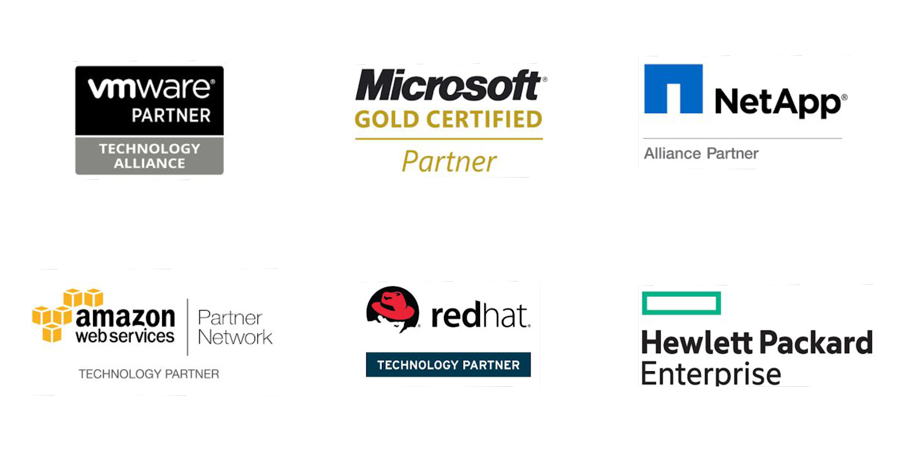
Vembu
Technology Partner

Slide 4
Vembu BDR Suite
Product Overview

Slide 5
Vembu BDR Suite
Vembu BDR Suite is a portfolio of products designed to backup multiple environments from
virtual to physical to cloud while addressing diverse and advanced use cases
Backup & Replication for VMware
Backup & Replication for Hyper-V
Backup for
Microsoft Windows
Backup for AWS
Backup for
Microsoft 365
Backup for
Google Workspace
Backup for
File Servers
Backup for Endpoints
Backup for
Applications

Slide 6
Vembu Backup
for Microsoft Windows

Slide 7
Vembu Backup for Microsoft Windows allows you to backup the entire disk or a selected partition of Windows machines including its Operating System(OS), boot information, system settings, applications, and files – even while the system is still being used.
Disk-Image based backup for Windows Machines
Supports backup for disks having more than 2 TB of data
Supports Bare-metal Recovery (BMR)
Backup
for
Microsoft Windows
Backup & Disaster Recovery

Slide 8
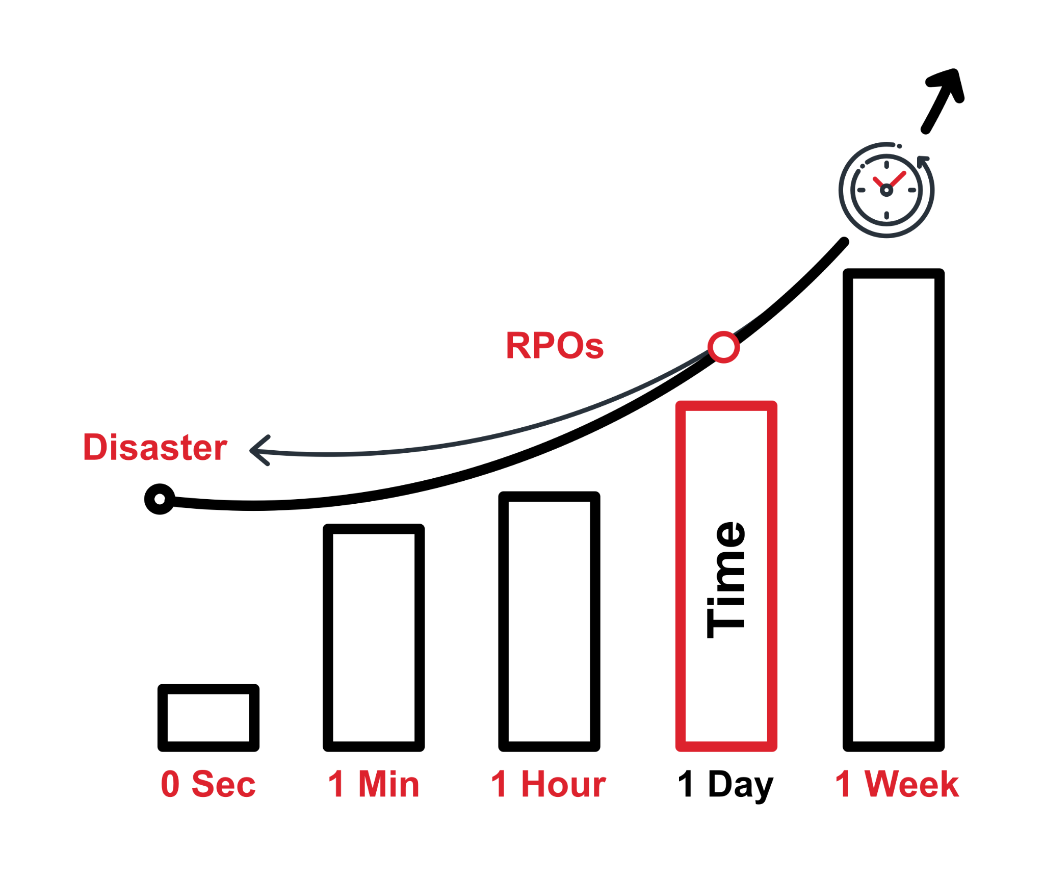
The RPO for your business can be set by the maximum amount of data that you can afford to loose if disaster strikes
With Vembu, you can also backup as frequently as every 15 minutes
You can also retain even years worth of data
Near Continuous Data Protection ensures that you don’t lose even minutes’ worth of data
Recovery Point Objective (RPO)
Backup & Disaster Recovery

Slide 9
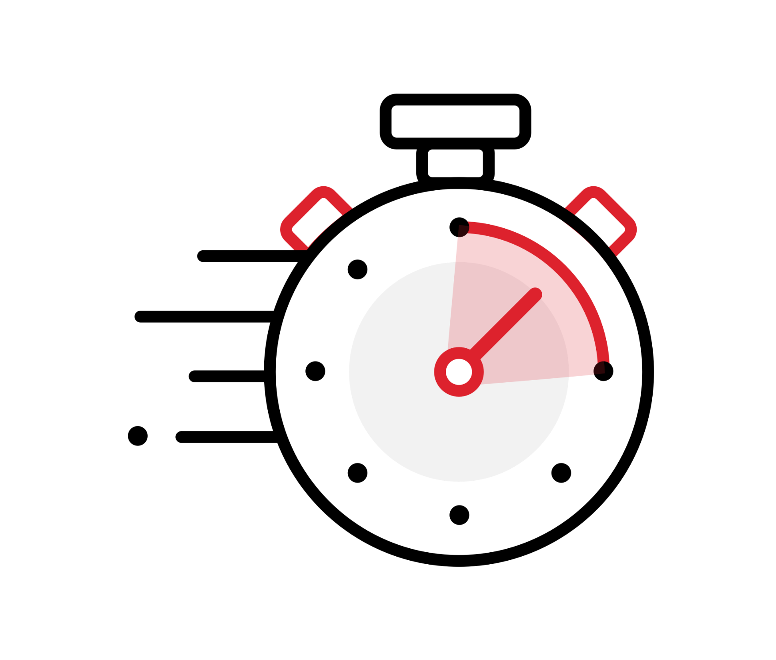
The time taken for a business to recover from the occurrence of a disaster is RTO
Downtime is not something every business can afford
With Vembu, you can recover your physical machines within couple of minutes
Vembu adheres to the industries’ best RTO and RPO of <15 min
Recovery Time Objective (RTO)
Backup & Disaster Recovery

Slide 10
Vembu BDR Suite
Deployment

Slide 11
Ideal setup for businesses looking to manage backups within their premises
Setup BDR Backup Server in your local environment and backup via LAN
Configure and manage backup jobs from BDR Backup Server GUI
Using Vembu Backup Agent (VBA), backup Windows machines to the storage repositories attached to the backup server.
On-premise Deployment - Simple
Vembu Backup Agent (VBA)
LAN
Vembu BDR Backup Server
Backup & Disaster Recovery

Slide 12
This deployment is recommended for large environments
Setup BDR Backup Server in your local environment and backup via LAN
Vembu BDR Client can be used to configure and manage backup jobs
Backup the Windows machines using client and store the backup data in the storage repositories attached to the backup server
On-premise Deployment - Distributed
LAN
Vembu BDR Client
Vembu BDR Backup Server
Backup & Disaster Recovery

Slide 13
This deployment is recommended for large environments
Setup BDR Backup Server in your local environment and backup via LAN
Send a copy of backup data to your secondary datacenter via LAN/WAN
Ensure a disaster-resistant environment by installing the Vembu Offsite DR Server in your secondary datacenter
Hybrid Deployment Scenario 1 (Offsite DR)
LAN
LAN/WAN
Vembu BDR Backup Server
Vembu Offsite DR Server
Backup & Disaster Recovery

Slide 14
This deployment is recommended for small and medium environments
Setup BDR Backup Server in your local environment and backup via LAN
Send a copy of backup data to Vembu Cloud via WAN connection
Ensure a disaster-resistant environment by signing up for Vembu Cloud DR
Hybrid Deployment Scenario 2 (Cloud DR)
LAN
WAN
Vembu BDR Backup Server
Vembu Cloud DR Server
Backup & Disaster Recovery

Slide 15
Cloud Service Providers can host Vembu Offsite DR Server in their data center
They can have a copy of backup data from the Vembu BDR Backup Servers to their data center over WAN
Offsite (or) Remote Deployment (CSP)
Customer Site
Cloud Service Provider - Data Center
LAN
WAN
Vembu BDR Backup Server
Vembu Offsite DR Server
Backup & Disaster Recovery

Slide 16
Setup Vembu BDR Backup Server and Vembu Offsite DR Server in remote office as well as branch office
Sync backup data between both the locations
Remote office
Branch office
Vembu BDR Backup Server
Vembu Offsite DR Server
LAN
Vembu BDR Backup Server
Vembu Offsite DR Server
Backup & Disaster Recovery

Slide 17
You can easily scale up the backup server when backup load increases
Backup requests will be equally shared between each backup server
Backup Server
Clustering
Vembu BDR Backup Server
Vembu BDR Backup Server
LAN
Server Cluster
Vembu BDR Backup Server
Vembu BDR Backup Server
Backup & Disaster Recovery

Slide 18
Vembu BDR Suite
Key features

Slide 19
Key Backup Features of Microsoft Windows Backup
Multi-host Backup
Dynamic Disk Backup
Backup Disks Parallelly
Create a backup job with multiple-hosts and configure to run parallel thus improving backup performance.
Vembu offers backup for dynamic disks in a Windows machine, and restore them granulary or mount the disks to the backup server.
Vembu now supports parallel backup of multiple disks from a single/ multiple hosts.
Synthetic Full Backup
Native Tape Backup Support
Backup Job Template
Synthetic full backups are created in the backup repository by merging the full backup and all subsequent incremental backups in the backup repository itself
The frequently used backup configuration settings or as per some predefined backup policies, you can utilize these templates to create new backup jobs quickly.
Archive your backup data on tape drives for long-term retention.

Slide 20
Key Recovery Features of Microsoft Windows Backup
RPO and RTO <15 mins
GFS Retention
Multiple Recovery Options
Minimize your downtime to less than 15 mins with quick VM recovery, disk mounts & granularly recover file/apps.
GFS retention helps to create restore points on a weekly, monthly, quarterly, and yearly basis.
Multiple restore options helps to restore the backup data granularly, perform cross-platform migration, instantly boot as VM, Download in various file-formats and also perform Bare-Metal Recovery
Instant Boot Live Migration
Applications item-level Recovery
Reliable Backups
A permanent migration process where the virtual/ physical machine backup that is instantly booted as VM can be migrated as an independent VM to a targeted VMware Host.
Granularly restore Microsoft applications at item level directly from the BDR Backup Server web GUI
Automated 3-tier backup verification – boot, mount & data integrity tests to ensure recoverability data.

Slide 21
Other Key Features of Microsoft Windows Backup
Efficient Storage Management
Compression
Backup Level encryption
Vembu BDR Backup Server utilizes VembuHIVE™ file system to effectively manage storage repositories..
Built-in compression and deduplication to reduce the storage space with the ability to scale as & when required.
Use system-generated passwords or add your own, to encrypt the backup data using AES-256 bit encryption algorithm.
Drive Rotation
Where it left off
Reporting
It helps you to use multiple external hard drives to store the backup data and swap them on a regular basis.
Even if there is a network failure or other interruptions during backup, the backup will automatically restart from where it left off during the previous schedule
Users can manage all their backups with Backup Status Reports, VM Status Reports, Integrity Report and Restore Report

Slide 22
Vembu BDR Suite
Disaster Recovery Scenarios

Slide 23
Restore the backed up physical machine by using Vembu Recovery CD for BMR
Bare Metal Restore (BMR) is a physical to physical (P2P) recovery, that builds a machine from the scratch.
Bare Metal Restore (BMR) - (P2P)
LAN
Vembu BDR Backup Server
Vembu Virtual Drive
Windows Machine
Restored Windows Machine
RAW / HDD
VHD
Backup & Disaster Recovery

Slide 24
Restore only affected disks/partitions instead of restoring entire machine
The backed up disk/partition can be restored to a new disk attached to the backup server.
Disk/ Partition Recovery
LAN
Vembu BDR Backup Server
Disk 0
Disk 0
Disk 1
Backup & Disaster Recovery

Slide 25
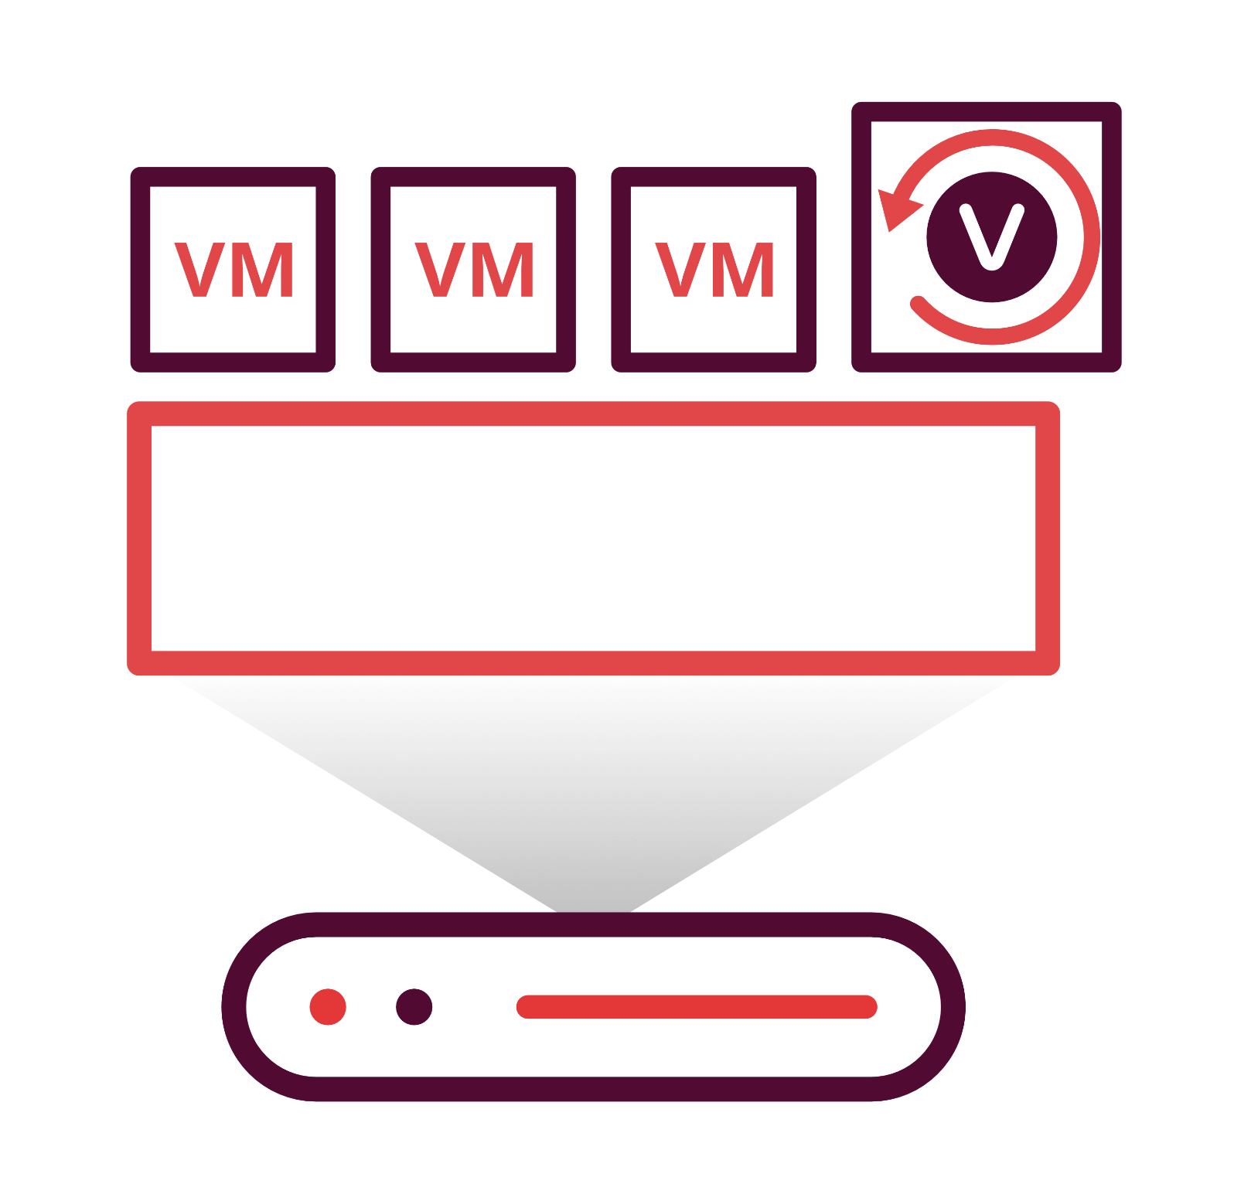
Instantly boot the backed up physical machine as a ready state VM on VMware/ Hyper-V/ KVM hypervisors by mounting the data through Vembu Virtual Drive
VMware
Instant Boot VM Recovery- (P2V)
LAN
Hyper V
Vembu BDR Backup Server
Vembu
Virtual Drive
KVM
Backup & Disaster Recovery

Slide 26
Restore files/folders from the backed up machine instantly without having to restore the entire backed up image
File Level Recovery
LAN
Vembu BDR Backup Server
File / Folder- level recovery
Backup & Disaster Recovery

Slide 27
Vembu helps you to restore Microsoft applications i.e. MS Exchange mails, MS SQL database/tables, MS SharePoint documents and MS AD Users/Roles granularly
Application Item Level Recovery
LAN
Vembu BDR Backup Server
Vembu
Virtual Drive
Backup & Disaster Recovery

Slide 28
Vembu Virtual Drive in Vembu BDR Backup Server stores the backup data in neutral file formats i.e. IMG, VHD, VHDX, and VMDK; with the help of the VembuHIVETM file system
For every incremental schedule, full virtual hard disk files will be created without using any additional storage
Vembu
Virtual Drive
LAN
VHD/VHDX
VMDK
RAW
Vembu BDR Backup Server
Vembu
Virtual Drive
Backup & Disaster Recovery

Slide 29
Vembu Backup for Microsoft Windows Licensing Model

Slide 30
Licensing
Subscription
Available Editions
Vembu offers licensing options at monthly & yearly subscriptions
24/7 support and major/minor upgrades included
Free
Standard
Perpetual
Free Workstation Backup
Backup entire disks or selected volumes of upto 10 Windows Workstations for free without any feature restrictions.
One time purchase with upgrades and support free for one year
After 1 year AMC of 20% of license fee to be paid for continued support & updates

Slide 31
Workstation
Server
Backup
for
Microsoft Windows
Subscription License
$15
$60
(Includes product updates, upgrades & standard technical support until subscription period)
per workstation/annum
per server/annum
Perpetual License
$37.50
$150
(Free maintenance & support for 1st year)
per workstation
per server
Backup & Disaster Recovery

Slide 32
Thank You
USA & CANADA
+1-512-256-8699
UNITED KINGDOM
+44-203-793-8668
Email
vembu-sales@vembu.com
vembu-support@vembu.com

